Slide 1
No. 65

Slide 2

QUADRATIC EQUATIONS
Sum based on Work

Slide 3

EX 4.2 6
Q.
A cottage industry produces a certain number of pottery articles in a day. It was
observed on a particular day that the cost of production of each article(in rupees)
was 3 more than twice the number of articles produced on that day. If the total
cost of production on that day was Rs.90, find the number of articles produced
and the cost of each article.
Sol.
Calculation
Let the number of articles produced in a day be x
Find two factors of 180 in such a way that by subtracting factors we get middle number.
Cost of production of each article
=
2x
+ 3
∴
2x +15 = 0
2
or
x - 6
=
0
180
Total cost of
production
Number
of articles
cost of each
article
∴
2x = -15
or
x = 6
180
Since last sign is ‘-’ Give middle sign to the bigger factor & opposite sign to smaller factor.
2
90
In a comparative statement whatever comes later is taken as ‘x’
=
×
What we have to find in this sum ?
-15
or
x =
x = 6
‘-’ sign means subtracting
3
45
90 =
x
It is given that …
(2x + 3)
2
3
15
15 - 12
=
3
90 =
2x²
+ 3x
Let us do the prime factorization of 180
No. of articles produced cannot be negative
+
–
90 × 2 = 180
15
12
∴
x
≠
-15
∴
x = 6
0 =
2x²
+ 3x
– 90
5
5
2
∴
2x²
+
3x
‒
90
=
0
1
∴
2x
+
3
=
2(6)
+
3
∴
2x²
+
15x
‒
12x
‒
90
0
=
=
12
+
3
=
15
∴
x
(2x + 15)
‒
6
(2x +15)
=
0
∴
6 articles are produced each day and cost of production of each article is Rs.15.
∴
(2x +15)
(x - 6)
=
0
∴
2x +15 = 0
or
x - 6
=
0

Slide 4
No. 66

Slide 5
QUADRATIC EQUATIONS
Sum based on two taps

Slide 6
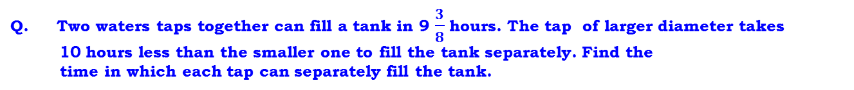









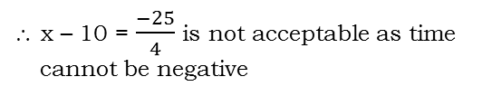



























EX 4.3 9
Q. Two waters taps together can fill a tank in 9 $\frac{3}{8}$hours. The tap of larger diameter takes 10 hours less than the smaller one to fill the tank separately. Find the
time in which each tap can separately fill the tank.
Find two factors of 1500 in such a way that by adding factors we get middle number.
Tank
Time required to fill a tank
Portion of tank filled in 1hour
∴
–8x²
+ 80x
+ 150x
– 750
= 0
Sol :
Let the time taken to fill a tank by smaller tap be ‘x’ hrs.
∴
–8x²
+ 230x
‘+’ sign means adding
Since last sign is ‘+’ Give middle sign to the both the factors
– 750
= 0
$$\frac{1}{2}$$
1
Dividing throughout by – 2
∴ The time taken by a larger tap
= (x – 10) hours
2 hrs
In a comparative statement whatever comes later is taken as ‘x’
∴
4x²
- 115x
+ 375
= 0
What we have to find in this sum ?
375 × 4 = 1500
$$\frac{1}{3}$$
Portion of the tank filled in 1 hour by smaller tap = $\left(\frac{1}{x}\right)$
1
3 hrs
∴
4x²
– 100x – 15x
+ 375
= 0
Portion of the tank filled in 1 hour by larger tap = $\left(\frac{1}{x−10}\right)$
$$\frac{1}{x}$$
∴
4x
(x – 25)
– 15
$$\frac{1}{x}$$
1
x hrs
(x – 25)
= 0
Smaller tap
∴
(x -25)
Time taken by both the taps together to fill the same tank
(4x – 15)
= 0
$$\frac{1}{x−10}$$
∴
x -25 = 0
$$\frac{1}{x−10}$$
1
or
4x – 15 = 0
= 9 $\frac{3}{8}$ ^{hours}
= $\frac{75}{8}$ ^{hours}
∴
x – 10 hrs
Larger tap
x = 25
or
4x = 15
∴
9 $\frac{3}{8}$
x = $\frac{15}{4}$
x = 25
or
= $\left(\frac{1}{\frac{75}{8}}\right)$
=$\left(\frac{8}{75}\right)$
= $\frac{75}{8}$
$$\frac{1}{\frac{75}{8}}$$
$$\frac{8}{75}$$
Portion of the tank filled in 1 hour by both taps
1
$$\text{= }\frac{8}{75}$$
Both taps
1500
If x = $\frac{15}{4}$, then
x – 10 = $\frac{15}{4}$ –10
= $\frac{15−40}{4}$
As per the given condition,
= $\frac{−25}{4}$
$$+$$
$$=$$
∴ x – 10 = $\frac{−25}{4}$ is not acceptable as time cannot be negative
∴
$$x−10$$
$$+ x$$
$$8$$
$$=$$
–
–
∴ x $≠ \frac{15}{4}$
$$x(x−10)$$
$$75$$
100
15
Hence x = 25
∴
$$2x−10$$
$$\frac{8}{75}$$
$$\frac{ }{x2−10x}$$
$$=$$
∴ x - 10
= 25 – 10
= 15
∴
75 (2x $−$10)
= 8(x² $−$ 10x)
∴
Time taken by larger tap alone is 15 hours and by smaller tap alone is 25 hours
∴
$−$ 750
150x
= 8x²
$−$ 80x

Slide 7
No. 67

Slide 8
QUADRATIC EQUATIONS
Word Problem based on work

Slide 9
Q)
For doing some work Ganesh takes 10 days more than John. If both work together they complete the work in 12 days. Find the number of days if Ganesh worked alone?
Sol.
Let the number of days required by John alone to complete the work be x days.
No. of days taken by Ganesh alone is (x + 10) days.
1 (x² + 10x)
= 12 (2x + 10)
Also number of days required by both to
complete the same work is 12 days
It is given that …
x²
+ 10x =
24x
+ 120
What we need to find ?
No. of days
Work done in 1 day
x²
Work
+ 10x
– 24x
– 120
= 0
Work done by John in 1 day =
1
x²
– 14x
– 120
= 0
1
2
1/2
Since we are subtracting the factors give middle term sign to the bigger factor and the opposite sign to the smaller factor
x²
– 20x
+ 6x
– 120
= 0
In a comparative statement whatever comes later is taken as x
1
3
1/3
Work done by Ganesh in 1 day =
x
(x – 20)
+ 6
(x – 20)
= 0
Work done in one day
1
6
1/6
To do one work
(x – 20)
(x + 6)
= 0
Work done by both in 1 day =
It takes two days
1
12
1/12
As per the given condition,
x – 20 = 0
or x + 6 = 0
Find two factors of 120 in such a way that by subtracting factors we get middle no. 14
x = 20
or x = – 6
1
x
1/x
+
=
The numbers of days cannot be negative
1
x+10
1/x+10
0
12
Hence, x = 20
x + 10
+ x
1
x ≠ – 6
=
x + 10
= 20 + 10
= 30
x(x + 10)
12
2x + 10
1
Ganesh alone worked for 30 days.
20
–
6
= 14
–
2
+
=
0
6
x² + 10x
12

Slide 10
No. 68

Slide 11
QUADRATIC EQUATIONS
Word Problem based on work

Slide 12
homework
Q)
Tinu takes 9 days more than his father to do a certain piece of work. Together
they can do the work in 6 days. How many days will Tinu take to do that work.
Sol.
Let the number of days required by father alone to do a certain piece of work be x days.
No. of days taken by Tinu alone is (x + 9)days.
1 (x² + 9x)
= 6 (2x + 9)
Also number of days required by both to
complete the same work is 6 days
x²
+ 9x =
12x
+ 54
It is given that …
What we need to find ?
x²
+ 9x
– 12x
– 54
= 0
Work done by Father in 1 day =
1
x²
– 3x
– 54
= 0
x²
– 9x
+ 6x
– 54
= 0
Work done by Tinu in 1 day =
x
In a comparative statement whatever comes later is taken as x
(x – 9)
+ 6
(x – 9)
= 0
Since we are subtracting the factors give middle term sign to the bigger factor and the opposite sign to the smaller factor
(x – 9)
(x + 6) = 0
Work done by both in 1 day =
54
Find two factors of 54 in such a way that by subtracting factors we get middle no. 3
As per the given condition,
x – 9 = 0
or x + 6 = 0
x = 9
or x = – 6
+
=
The number of days cannot be negative
+
–
6
9
Hence, x = 9
x + 9
+ x
1
9 – 6 = 3
x + 9
= 9 + 9
= 18
=
x(x + 9)
6
Tinu alone requires 18 days to complete the work.
2x + 9
1
=
x² + 9x
6

Slide 13
No. 69

Slide 14
QUADRATIC EQUATIONS
Word Problem based on work

Slide 15

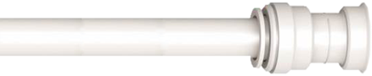
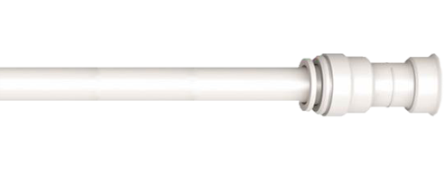
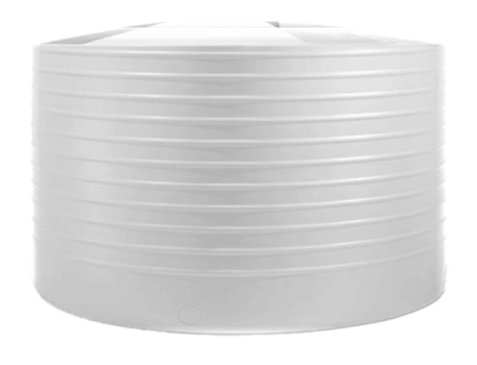

Q)
One tank can be filled up by two taps in 6 hours. The smaller tap alone takes
5 hours more than the bigger tap alone. Find the time required by each tap
to fill the tank separately.
There are two taps one bigger and one smaller tap.
Sol.
In a comparative statement whatever comes later we will assume it as x
Let the time taken to fill a tank by a bigger tap alone be x hrs.
What do we have to find ?
The time taken by smaller tap alone is (x + 5) hrs.
Time taken by both the taps together to fill the same tank is 6 hrs.
Portion of the tank filled in 1 hr by bigger tap =
capacity
Portion of the Tank filled in 1 hr by smaller tap
Tank
Time required to fill a tank
Portion of tank filled in 1hour
capacity
1
2 hrs
$$\frac{1}{2}$$
1
3 hrs
$$\frac{1}{3}$$
Tank filled in 1 hr by both taps together =
capacity
6 hours
x + 5 hours
x hours
1
x hrs
$$\frac{1}{x}$$
As per the given condition,
1
x + 5 hrs
$$\frac{1}{x+5}$$
+
=
$$\frac{1}{6}$$
1
6 hrs

Slide 16
Q.
One tank can be filled up by two taps in 6 hours. The smaller tap alone takes
5 hours more than the bigger tap alone. Find the time required by each tap
to fill the tank separately.
Since we are subtracting the factors give middle term sign to the bigger factor and the opposite sign to the smaller factor
30
Find two factors of 30 in such a way that by subtracting factors we get middle no. 7
Sol.
+
=
x + 3 = 0
or x – 10 = 0
x = – 3
or x = 10
x + 5
+ x
1
+
–
=
3
10
x(x + 5)
6
x is the time taken by bigger tap
2x + 5
1
10 – 3 = 7
=
x ≠ – 3
x² + 5x
6
1 (x² + 5x)
= 6 (2x + 5)
Hence, x = 10
x²
+ 5x =
12x
+ 30
x + 5
= 10 + 5
= 15
x²
+ 5x
– 12x
– 30
= 0
x²
– 7x
– 30
= 0
Time taken by bigger tap alone is 10 hrs
and smaller tap alone is 15 hrs.
1
x²
+ 3x
– 10x
– 30
= 0
x
(x + 3)
– 10
(x + 3)
= 0
(x + 3)
(x – 10) = 0

Slide 17
No. 70

Slide 18
QUADRATIC EQUATIONS
Word Problem based on cost

Slide 19
homework
(Q)
The cost of bananas is increased by Re. 1 per dozen, one can get 2 dozen less for
Rs. 840. Find the original cost of one dozen of banana.
According to the question
+++
Sol.
Let the cost of banana per dozen be Rs. x.
1
Total Amount
Old no. of dozens
1
∴
=
Amount for which bananas are bought = Rs. 840
No. of dozens =
x² + x
Cost per dozen
840
420
Number of dozens of bananas for Rs. 840 =
∴
x² + x =
420
Since we are subtracting the factors give middle term sign to the bigger factor and the opposite sign to the smaller factor
x
What do we have to find?
Total amount given is…
New no. of dozens
New cost of bananas per dozen = Rs.(x + 1)
If I have Rs.100 and cost per dozen is Rs.20, then how many dozens will I be able to buy ?
∴
x²
+ x
– 420
= 0
1
If cost per dozen increases one will get less no. of dozens
∴
Amount remains the same
840
x²
– 20x
+ 21x
– 420
= 0
New no. of dozens of bananas for Rs. 840 =
∴
x
x + 1
(x – 20)
+ 21
(x – 20)
= 0
As per given condition,
42
∴
(x – 20)
(x + 21)
= 0
0
Old no. of dozens
∴
x – 20 = 0
or x + 21 = 0
Amount
Cost per dozen
No. of dozens
–
= 2
∴
x = 20
or x = – 21
= 5
100
10
100
–
+
The cost of bananas cannot be negative.
= 10
2
21
0
Find two factors of 420 in such a way that by subtracting factors we get middle no. 1
New no. of dozens
10
∴
840
–
=
2
Old no. of dozens
100
21 – 20 = 1
∴
x ≠ –21
100
20
– New no. of dozens
20
= 5
= 2
Hence x = 20
x + 1
– x
2
∴
=
∴
The original cost of one dozen of banana is Rs. 20.
x (x + 1)
840
Notes:
x

Slide 20
No. 71

Slide 21
QUADRATIC EQUATIONS
Word Problem based on cost (Businessman)

Slide 22

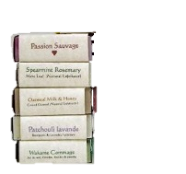

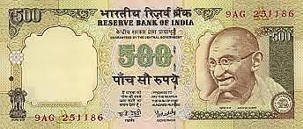
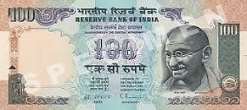


Q. A businessman bought some items for Rs. 600, keeping 10 items for himself he sold the remaining items at a profit of Rs. 5 per item. From the amount received in this deal he could buy 15 more items. Find the original price of each item.
Sol.
Let original price of each item be Rs. x
Total CP
CP of 1 item
Profit = CP of 15 items
CP of 1 item
Rs. x
But how many items did he purchase?
With the profit amount he could buy 15 more items
Amount received in deal = Profit
No. of items sold × SP of 1 item
we know that,
Total SP – Total CP = Profit
Total CP
Rs.600
15 × CP of 1 item
No. of items purchased
How many items did he sell?
No. of items sold
( – 10)
x
SP of 1 item
Rs.( )
+ 5
Total SP
Rs. ( – 10)
(x + 5)
No. of items purchased – 10 items he kept
SP of 1 item =
CP of 1 item + Profit per item
Profit =
15
× x
= Rs.15x
( – 10)
(x + 5)
–
600
=
15x

Slide 23
Q. A businessman bought some items for Rs. 600, keeping 10 items for himself he sold the remaining items at a profit of Rs. 5 per item. From the amount received in this deal he could buy 15 more items. Find the original price of each item.
Sol.
As per the given condition
Since we are subtracting the factors give middle term sign to the bigger factor and the opposite sign to the smaller factor
∴ x²
+ 12x
– 10x
– 120
= 0
Find two factors of 120 in such a way that by subtracting factors we get middle no. 2
120
( – 10 )
12
–
10
= 2
(x + 5)
–
600
=
15x
Lets remove x from denominator
= 0
∴ x
(x + 12)
– 10
(x + 12)
∴ (x + 12)
(x – 10)
= 0
(x + 5)
(x + 5)
–
=
– 10
600
15x
∴ x + 12 = 0
or
x – 10 = 0
+
12
–
10
∴ x = – 12
or
x = 10
∴ 600
– 10x
– 50
– 600
= 15x
x = – 12 is not acceptable because
cost cannot be negative.
Multiplying ‘x’ on both sides, we get
∴ 3000
– 10x²
– 50x
= 15x²
∴ x = 10
∴ 0 = 15x²
+ 10x²
+ 50x
– 3000
Original price of each item is Rs.10.
∴ 25x²
+ 50x
– 3000
= 0
Dividing throughout by 25, we get
∴ x²
+ 2x
– 120
= 0
1

Slide 24
TThank Youk You

